Slide 1
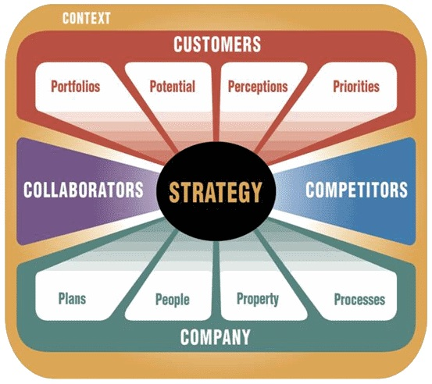




Our approach will be to quickly review and synthesize the market information related to potential opportunities and offer strategic options for marketing and growing MDM 150 and In Line LDM & MDM
Opportunity ANALYSIS
Customer-Driven Strategy Development
5C’s Analysis
1. Portfolios
How will you segment your customers into separate, manageable portfolios?
2. Potential
What is the revenue, profit, or other potential of each customer portfolio?
3. Perceptions
How do these portfolios perceive your organization, products, and services?
4. Priorities
What are each portfolio's primary needs that, if met, can drive more business?
Source: Capital Letters and Baker Strategy Group

Slide 2
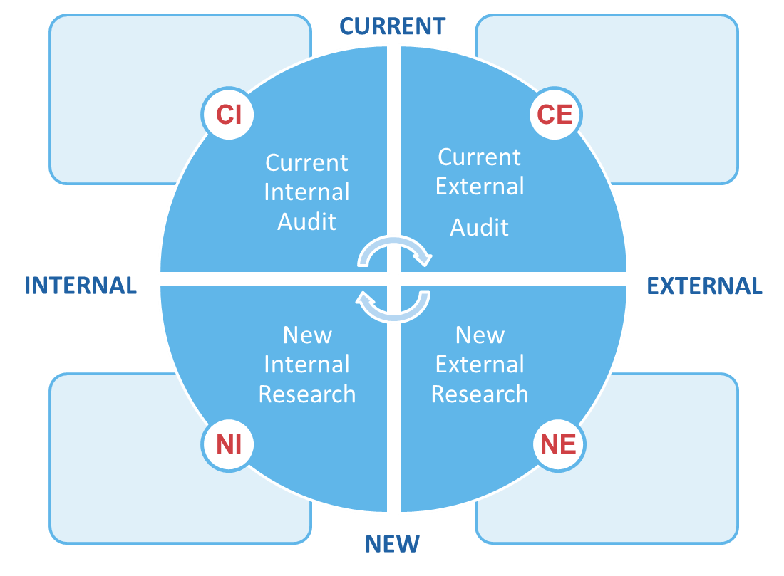
We follow a structured approach to assess the market opportunity and identify where ISS will have the greatest opportunities for successful adoption
Market Analysis
Documents and analysis currently available from ISS and its partners
In-house research studies
Purchased industry reports
Product roadmaps
Technical reports
Internal reports
Business plan
Company reports
Industry publications
Analyst reports
Market reports
Existing market, competitor, and industry data analysis
Conducting new qualitative and quantitative research for market insights
Expert interviews
Channel interviews
Customer interviews
Interviews for an article
Conducting new qualitative and quantitative research for market insights
5C’s Assessment
Internal staff interviews
Surveys and assessments
Source: Capital Letters and Baker Strategy Group

